Slide 1
Making Sense of the Score:
Connecting Research and Clinical Practice for Measurement-Based Care
BH Grand Rounds | October 1st, 2026
Musa Yilanli, MD; Courtney Cleminshaw-Mahan, PhD; Ellie Nienaber, BA
Notes:
Good morning, everyone! I appreciate you all being here bright and early. My name is Courtney Cleminshaw-Mahan. I am a psychologist on the outpatient Westerville CTH outpatient team. I have no disclosures. Now that I have introduced myself, turn to your neighbor and if it is someone you do not know, introduce yourself, because during the next hour, we are going to have many opportunities to take advantage of our in-person setting today and practice some skills together. Specifically, this presentation has several objectives

Slide 2
Start of Training
If this is your first time using text-in attendance,
text your NCH email to (844) 980-3318

Slide 3
Objectives
By the end of this session, attendees will be able to...
Understand the connection between research and practice relative to measurement-based care (MBC) in behavioral health.
Formulate questions related to the implementation of MBC for a multidisciplinary panel from across the hospital.
Incorporate measurement findings, multiple perspectives, and functional goals into clinical decision making.
Explain how specific measures can be used in different stages of MBC.

Slide 4

Measurement-Based Care (MBC)
Systematic collection of patient-reported measures to monitor treatment progress and inform clinical decision-making (Scott & Lewis, 2015)
What is required for MBC?
What is helpful for MBC?

Slide 5
BENCHMARK Research Focus
Psychometric Properties
Clinical Application Tools
Reliability
Validity
Factor structure
Retest dependability
Measurement invariance
Nationally-representative norms
Clinical significance benchmarks
Minimally important difference (MID)
Reliable change indices (RCI)
Notes:
Reliability: does it measure something real? Is this score correctly signaling to something?
Norms: what’s typical for this age? How does this child compare to others their age?
Reliable change: is the observed change real or is it “noise?”
Clinical significance benchmarks: how concerning is this score? How does it “measure up” to other kids?

Slide 6
The Goal?
Provide psychometric support for commonly used measures
Create clinically-relevant tools to help close the research to practice gap
Identify measures that may provide differential information throughout MBC

Slide 7
Implementation of MBC
Case Conceptualization
Use of patient-generated data and multi-informant reporting to support diagnostic clarification.
Treatment Planning
Use of baseline data to help guide treatment goals and select appropriate treatment strategies and modalities.
Progress Monitoring
Use of routine measure administration to monitor response to treatment, treatment effectiveness, and adjust treatment as needed.
Discharge/Termination
Use of quantitative data to assist with decision-making relative to readiness for discharge.

Slide 8

Case Example
Jordan (12F)
Seen in outpatient BH clinic with parents
School impairment, forgetfulness, and increased frustration
Notes:
Jordan is a 12-year-old female with declining grades, incomplete assignments, forgetfulness, and increasing homework frustration.
Her parents brought her in to be seen in an outpatient BH clinic after these concerns got worse going back to school this year.

Slide 9
Case Conceptualization
PSC-17: The PSC-17 provides a broad screening of potential behavioral health diagnoses. Information is meant to help guide assessment, identifying categories to explore further.
Total: 17 (score is positive if ≥ 15)
Attention: 8 (score is positive if ≥ 7)
Internalizing: 5 (score is positive if ≥ 5)
Externalizing: 4 (score is positive if ≥ 7)

Slide 10
Factor Structure and Reliability
(Youngstrom et al., in preparation)
Three-factor scale: attention, externalizing, and internalizing
  Items do not collapse onto a general factor, but are “subsets” of the total score
  Validated as subset scores with meaningful variance on their own
Subset | Alpha (α) | Construct Measurement | Omega (ω) | Construct Measurement
Attention | 0.82 | Good | 0.88 | Good
Externalizing | 0.80 | Good | 0.90 | Excellent
Internalizing | 0.78 | Acceptable | 0.91 | Excellent
Notes:
The PSC-17 is a reliable and valid measure of broad mental and behavioral health concerns.
It has three subscales: attention, externalizing, and internalizing.

Slide 11

Validity
(Youngstrom et al., in preparation)
Attention Subset | r
Vanderbilt Symptom Total | 0.82
Vanderbilt Inattention Total | 0.74
Vanderbilt Hyperactivity Total | 0.78
Why the PSC-17?
Total: 17
Attention: 8
Internalizing: 5
Externalizing: 4
Internalizing Subset | r
CHRT Suicidal Thoughts Total | 0.63
VQIDS Total (Depression) | 0.63
NQLS Total (Quality of Life) | -0.43
Externalizing Subset | r
CHRT Propensity Total | 0.82
Vanderbilt Hyperactivity Total | 0.66
NQLS Total (Quality of Life) | -0.41

Slide 12
Case Conceptualization
Youth-report Vanderbilt yields 6 symptoms of inattention and 2 symptoms of hyperactivity/ impulsivity that occur "often" or "very often"
  Plus 3 total problem areas.
Parent-report Vanderbilt yields 7 symptoms of inattention and 3 symptoms of hyperactivity/ impulsivity that occur "often" or "very often"
  Plus 4 total problem areas.
Teacher-report Vanderbilt yields 8 symptoms of inattention and 2 symptoms of hyperactivity/ impulsivity that occur "often" or "very often"
  Plus 3 total problem areas.
Subscale scores are positive if ≥ 12 (i.e., at least 6 symptoms)

Slide 13
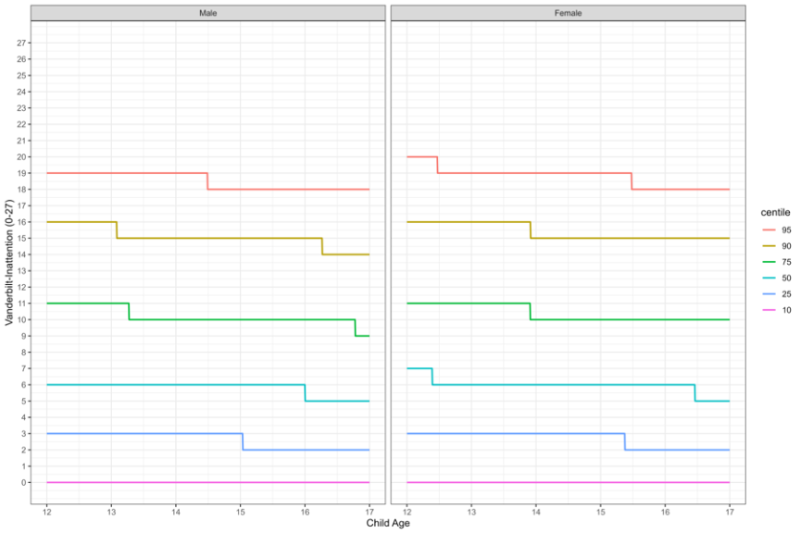
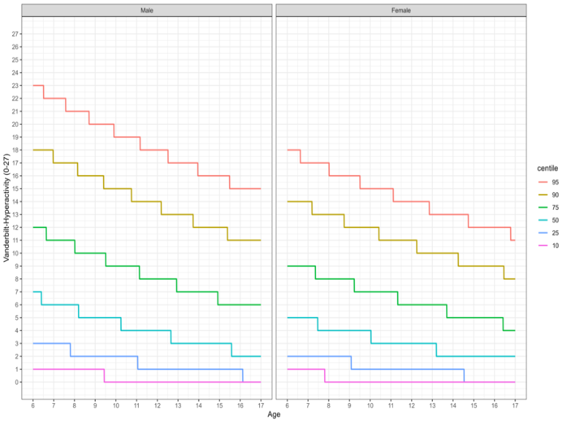
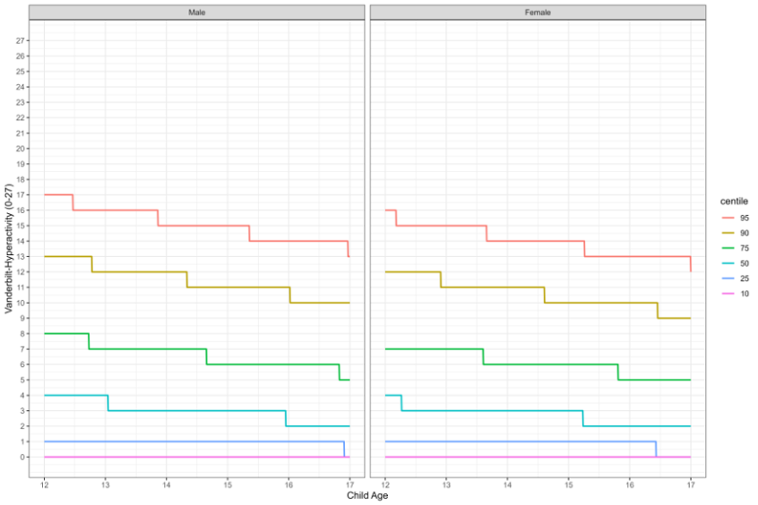
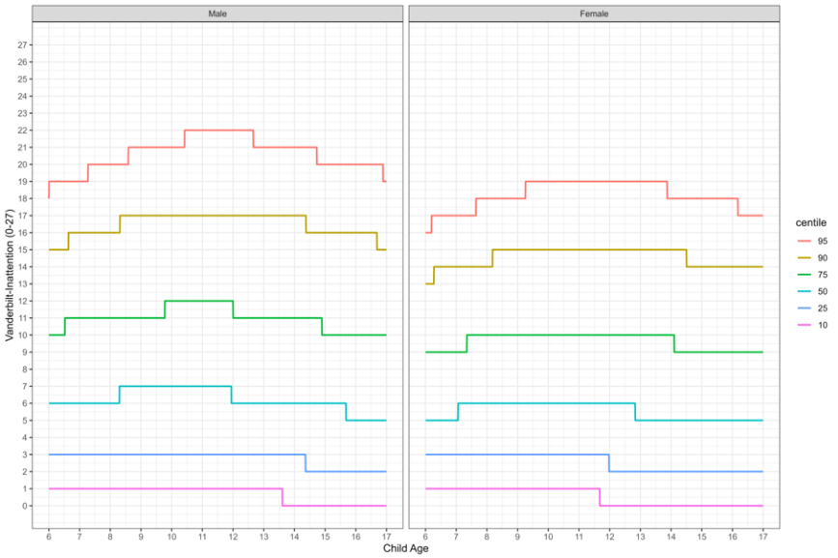
Norms
(Evans et al., under review)
Parent-Reported Inattention: 80th percentile
Parent-Reported Impulsivity/ Hyperactivity: 50th percentile
Self-Reported Inattention: 80th percentile
Self-Reported Impulsivity/ Hyperactivity: 55th percentile

Slide 14

Integrating Perspectives (Evans et al., under review)
Assess, then inquire…
  As ADHD symptoms increase, parent-child agreement on ADHD symptoms decrease
  As depression symptoms increase, parent-child agreement on ADHD symptoms decrease
Vanderbilt performance scale shows limited sensitivity and evidence of label misattribution
  Columbia Impairment Scale, Impairment Rating Scale or Weiss Functional Impairment Rating Scale (WFIRS) for ADHD-related impairment
  Nationwide Quality of Life Scale (NQLS) for overall quality of life

Slide 15
Implementation of MBC
Case Conceptualization
PSC-17 shows elevated attention and internalizing symptoms.
Vanderbilt confirms ADHD, predominately inattentive type.
NQLS shows overall low quality of life.
Treatment Planning
Use of baseline data to help guide treatment goals and select appropriate treatment strategies and modalities.
Progress Monitoring
Use of routine measure administration to monitor response to treatment, treatment effectiveness, and adjust treatment as needed.
Discharge/ Termination
Use of quantitative data to assist with decision-making relative to readiness for discharge.

Slide 16
Treatment Planning
Data can be used to inform:
  Treatment modality
    Parent-behavior management training (PBMT)
  Goals of treatment
    Patient will improve compliance with behavioral
    expectations at home and school
  Treatment modifications
    Medication adjustments

Slide 17





Does MBC Change Medication Outcomes?
(Guo et al., 2015; Epstein et al., 2016; Zhu et al., 2021)
ADULT DEPRESSION RCT · N = 120 · GUO 2015
CLUSTER RCT · 50 PRACTICES · EPSTEIN 2016
Same drugs in both arms. The only difference: scores guided the dosing.
Pediatric ADHD in primary care
QI program
Usual care
MBC
73.8%
Vanderbilt portal + training + workflow changes
Practices kept their usual ADHD care
Usual care
28.8%
Parent-rated: +2.4 points on medication
Remission at 24 weeks; faster (10.2 vs 19.2 weeks), no more side effects
–
Teacher-rated: no difference
Bundled program: rating scales’ own effect unknown
OR 1.83
Zhu 2021 meta-analysis: 7 RCTs, 2,019 adults with depression, all on medication
Remission (OR 1.83) and adherence (OR 1.68) improved; response no different; few trials, high bias risk
The medication matters. So does measuring and adjusting it.

Slide 18
Implementation of MBC
Case Conceptualization
PSC-17 shows elevated attention and internalizing symptoms.
Vanderbilt confirms ADHD, predominately inattentive type.
NQLS shows overall low quality of life.
Treatment Planning
The family agrees to begin medication management and outpatient therapy.
Vanderbilt and NQLS scores show need to improve school-related satisfaction and performance.
Progress Monitoring
Use of routine measure administration to monitor response to treatment, treatment effectiveness, and adjust treatment as needed.
Discharge/ Termination
Use of quantitative data to assist with decision-making relative to readiness for discharge.

Slide 19
Progress Monitoring
After 60 days, measures are re-administered
Jordan's scores improve
Notes:
Jordan is a 12-year-old female with declining grades, incomplete assignments, forgetfulness, and increasing homework frustration.
Her parents brought her in to be seen in an outpatient BH clinic after these concerns got worse going back to school this year.

Slide 20
Progress Monitoring
PSC-17:
Total: 13 (score is positive if ≥ 15)
Attention: 5 (score is positive if ≥ 7)
Internalizing: 5 (score is positive if ≥ 5)
Externalizing: 3 (score is positive if ≥ 7)
Parent-report Vanderbilt yields 4 symptoms of inattention and 2 symptoms of hyperactivity/ impulsivity
  Plus 4 total problem areas.
Teacher-report Vanderbilt yields 5 symptoms of inattention and 2 symptoms of hyperactivity/ impulsivity
  Plus 3 total problem areas.
After 60 days, measures are re-administered
Jordan's scores improve
Notes:
Jordan is a 10-year-old female with declining grades, incomplete assignments, forgetfulness, and increasing homework frustration.
Her parents brought her in to be seen in an outpatient BH clinic after these concerns got worse going back to school this year.

Slide 21
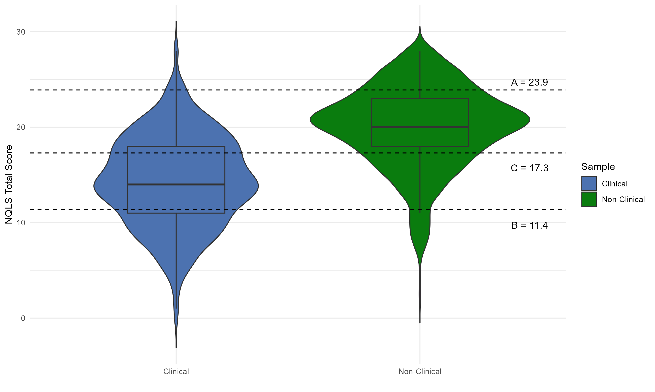
Reliable Change (RCI)
(Nienaber et al., under review)
Statistic | Value | Met? | Meaning
MID | 2.14 | Yes | A change in NQLS score of at least 3 points indicates personally noticeable change.
RCI (90) | 5.19 | Yes | The observed change reflects genuine change in quality of life opposed to “noise” with 90% confidence.
RCI (95) | 6.19 | No | We cannot say with 95% confidence that the observed change is genuine.
Jordan’s reported quality of life increased from 11 to 17 (6-point improvement) during the first 60 days of treatment.
What does it mean?

Slide 22
Clinical Significance Benchmarks (Nienaber et al., under review)
A = “Away”
Clinical mean + 2*SD
C = “Crossing Closer”
Crossing the estimated boundary (norm vs clinical)
B = “Back”
Non-clinical mean - 2*SD
**Scores are relative based on target population**
Notes:
MAP vs Normative, MAP youth scored an average of 5 points lower than the normative sample.
More than 2x the MID, this change is representative of an underlying latent trait difference.

Slide 23
Reading the Vanderbilt as a Provider
(Wolraich et al., 2003; NICHQ Vanderbilt Assessment Scales; Epstein et al., 2010)
Vanderbilt form (schematic)
1
ADHD symptoms
TITRATION TARGET
9 inattentive + 9 hyperactive
Compare parent (evenings) vs teacher (peak effect) before changing dose
1
ADHD symptoms
2
Oppositional / conduct
DON’T CHASE WITH DOSE
2
Oppositional / conduct
ODD and conduct screen
Persists despite ADHD control: add parent training or behavioral care
3
Anxiety / depression
3
Anxiety / depression
RULE OUT FIRST
7 items, both forms
Anxiety can mimic inattention; treat the comorbidity, don’t raise the dose
4
Performance
Parent: overall school, reading, writing, math, parents, siblings, peers, activities
4
Performance
MOST OVERLOOKED
Rated 1-5, both forms
Assignments and organization lag behind symptoms: add school supports
Teacher: reading, math, writing, peers, directions, disrupting class, assignments, organization
5
Side effects
TOLERABILITY
Follow-up forms
Appetite, sleep, rebound irritability, dulled affect, tics, hallucinations
5
Side effects
Symptoms count if often/very often · performance problem at 4–5 · read every section !!!

Slide 24

Timing and Setting Explain Score Changes
(De Los Reyes & Kazdin, 2005; Epstein et al., 2010; Eng et al., 2023; Banister et al., 2026)
Stimulant effect across the day (extended-release; duration varies by formulation)
7–8 AM
8 AM–3 PM · School
3–9 PM · Homework
Parent sees
Teacher sees peak effect: morning vs afternoon classes differ
Parent sees effect wearing off
Pattern you see | Possible explanation | What to ask or do
Teacher improves, parent doesn’t | Teachers rate school hours at peak effect; parents rate mornings and evenings | Ask about homework time; consider longer coverage or an afternoon dose
Better in morning classes than afternoon | Dose wearing off, or a subject-specific learning problem (e.g., math) | Ask which class and what time; consider academic testing
Scores swing between visits | Missed doses, weekends off, or raters describing different days | Ask which days they rated; check adherence
**Informant disagreement is information, not error: ask when and where**

Slide 25
Implementation of MBC
Case Conceptualization
PSC-17 shows elevated attention and internalizing symptoms.
Vanderbilt confirms ADHD, predominately inattentive type.
NQLS shows overall low quality of life.
Treatment Planning
The family agrees to begin medication management and outpatient therapy.
Vanderbilt and NQLS scores show need to improve school-related satisfaction and performance.
Progress Monitoring
All scores have improved with medication and therapy for 60 days.
Her parents report decreased conflict in the home, and she is showing more signs of independence with schoolwork.
Discharge/ Termination
Use of quantitative data to assist with decision-making relative to readiness for discharge.

Slide 26
Key Takeaways
The same score on the same measure can mean different things at different ages
Data-guided decision making can support clinical judgment
  Keep it brief and routine
Collaborate with families to set goals, and select measures that align with your desired outcome
Track trends in score changes over time
  Share findings back to the family
New tools are consistently emerging to support clinicians in implementation of MBC

Slide 27
Q&A led by Dr. Butter
Courtney Cleminshaw-Mahan, PhD,
Ellie Nienaber, BA, & Musa Yilanli, MD,

Slide 28
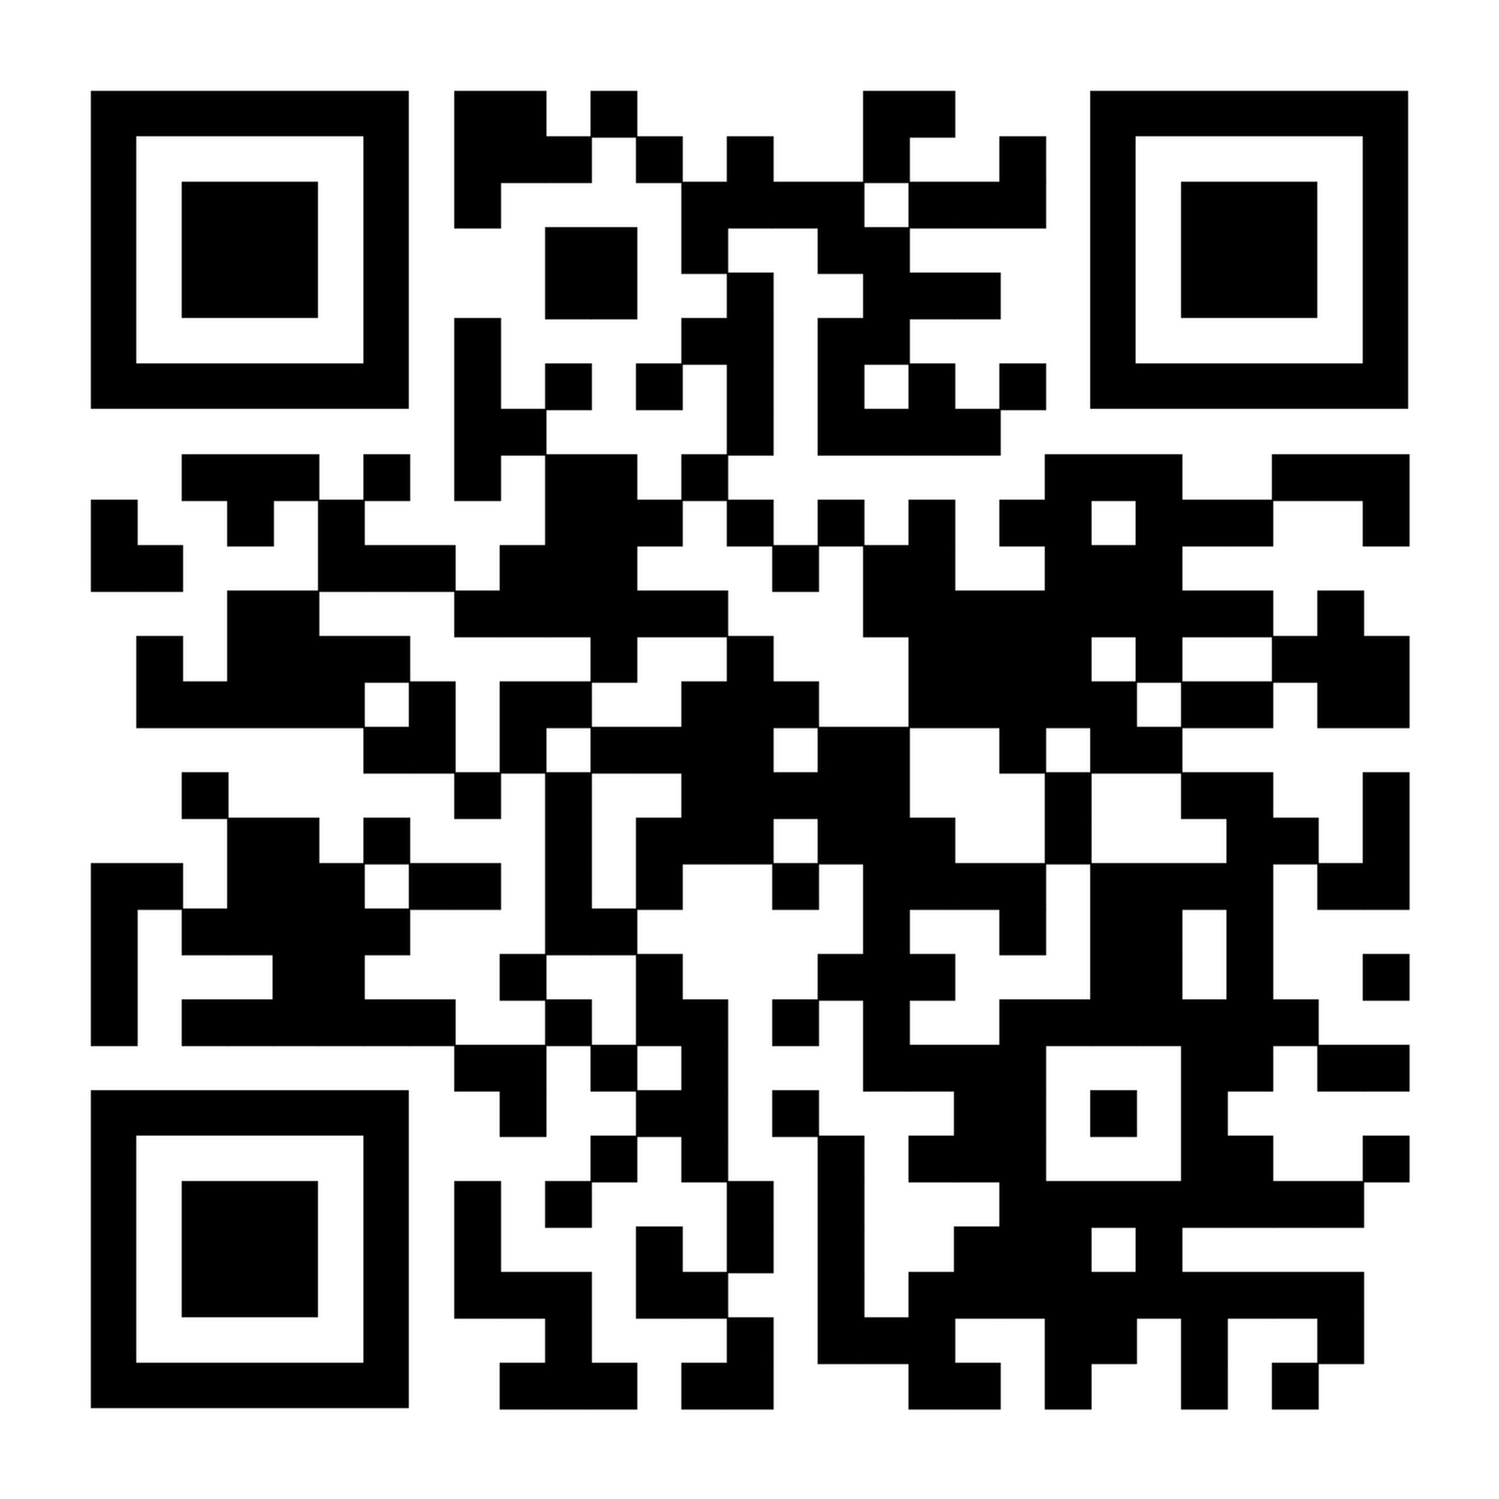
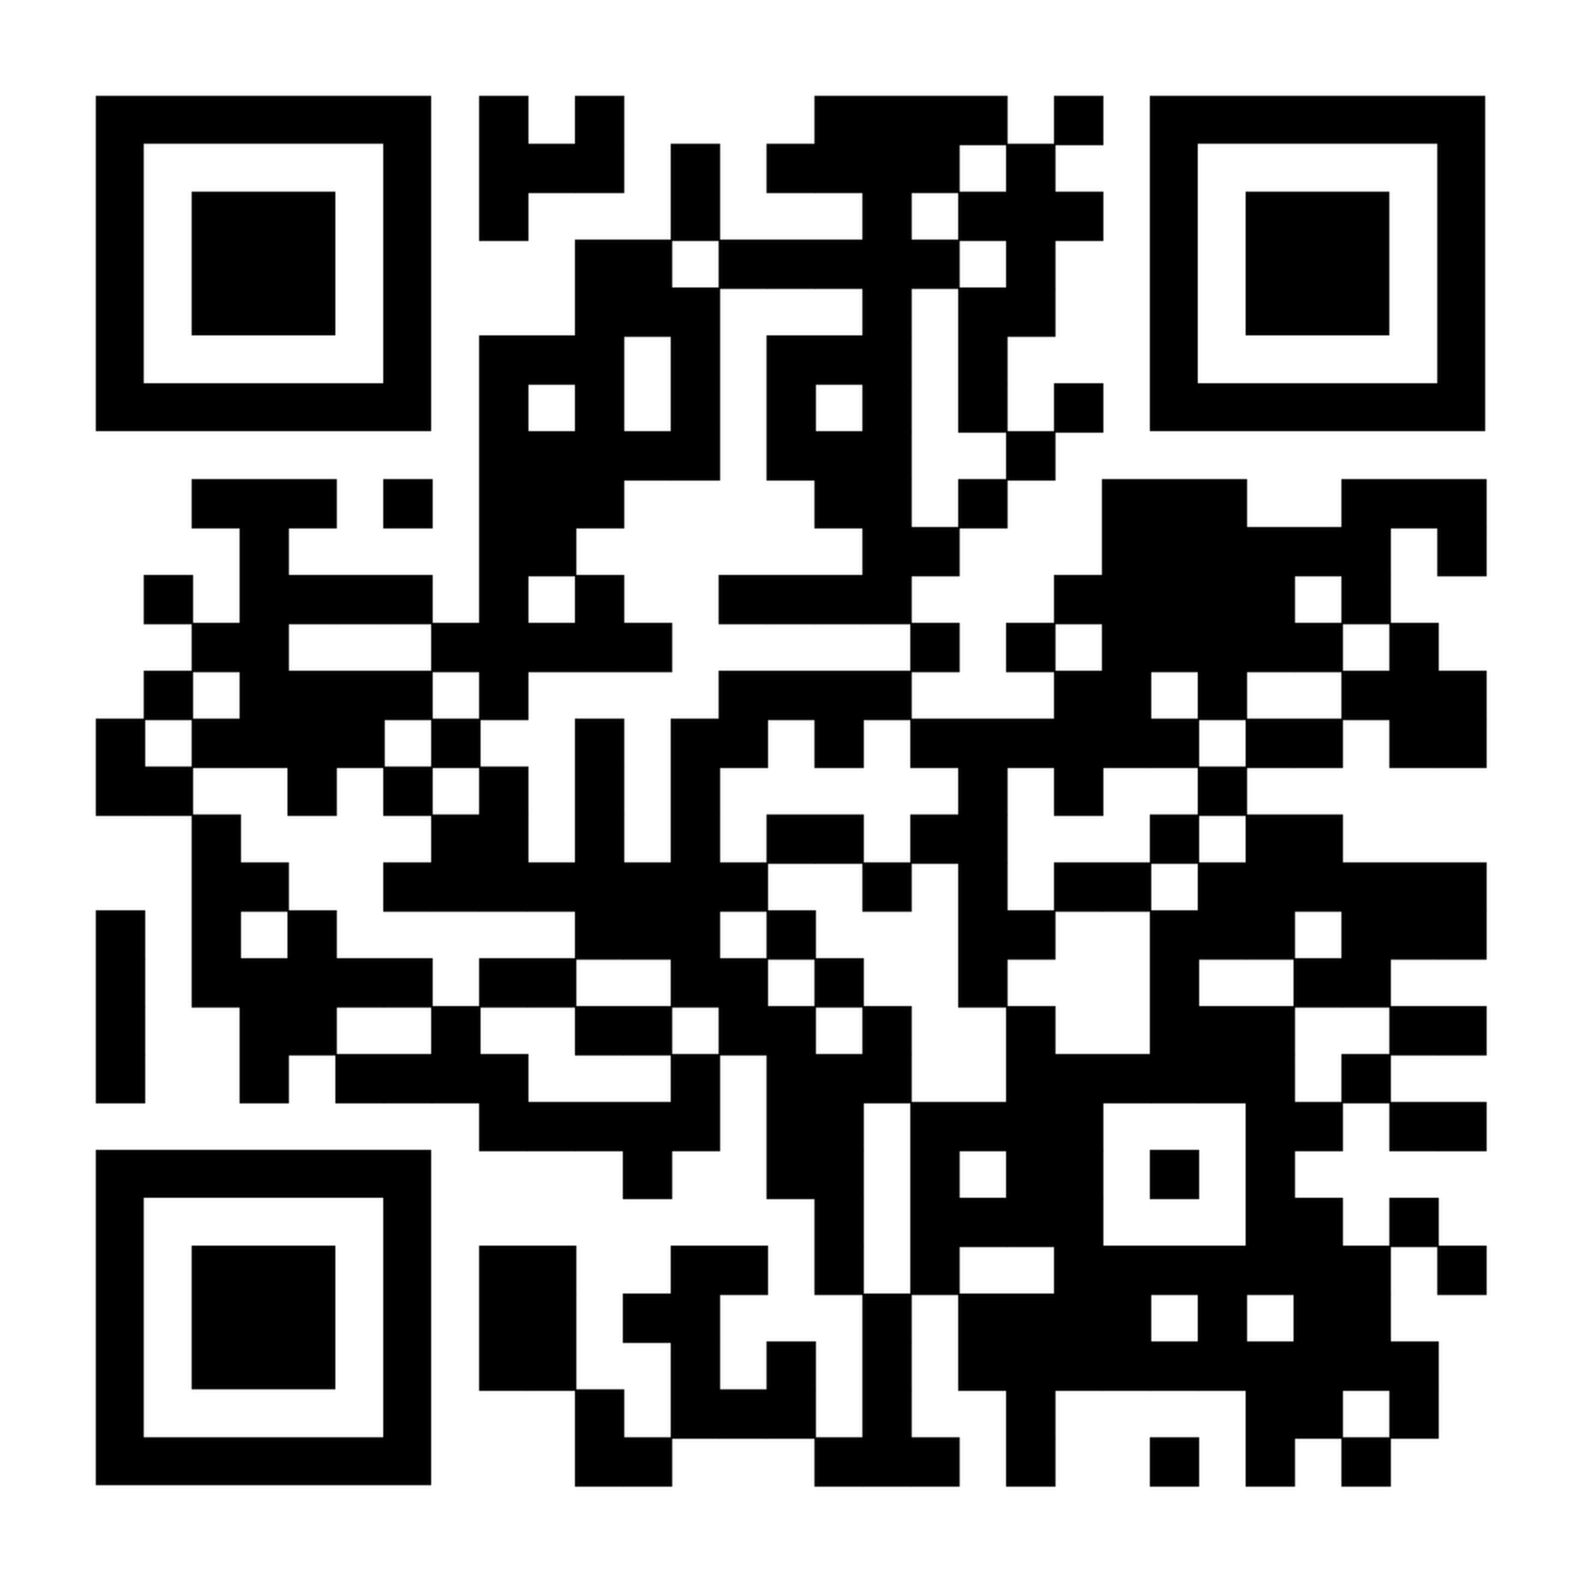
Thank You!
MBC Anchor Resources
Slides and External Resources
Research Collaborators
Eric Youngstrom, PhD
Steve Evans, PhD
Mary Fristad, PhD, ABPP
Nathan Lutz, PhD
Kevin Stephenson, PhD
Emily Rosenthal, PhD
Julie Sarno Owens, PhD
Shreya Kupur Bhaskar
Yinuo Liu
Marissa McClellan
Jonathon Covarrubias
Kim Jones
Brittany Grate
RISE 2026 Cohort
MAP Clinicians
Hughes Team

